Slide 1
Introduction to Fixed Income World
Anton Ivanov
Moscow 2015

Slide 2
Let Me Introduce Myself…
10/2012: CMF MSU 1st year student
07/2013: Sberbank CIB Risk Management Intern
09/2013: Sberbank CIB Risk Management Jr. Analyst
07/2014: Graduated Financial University under the Government of the Russian Federation (with honors)
06/2015 OJSC Sberbank of Russia CIB Risk Management Division Lead Specialist

Slide 3
Course Objectives
Describe important fixed income securities classes and markets
Describe interdependencies and the roles of the different players in the debt markets
Develop tools for valuing fixed income securities and managing interest rate risk
Develop economic intuition

Slide 4
Course Covers
Traditional bonds and term structure concepts
Fixed income derivatives
Interest rate modeling

Slide 5
Contents
Features of Debt Securities
Market Players Objectives
Overview of Bond Sectors
Risks Associated with Debt Securities

Slide 6
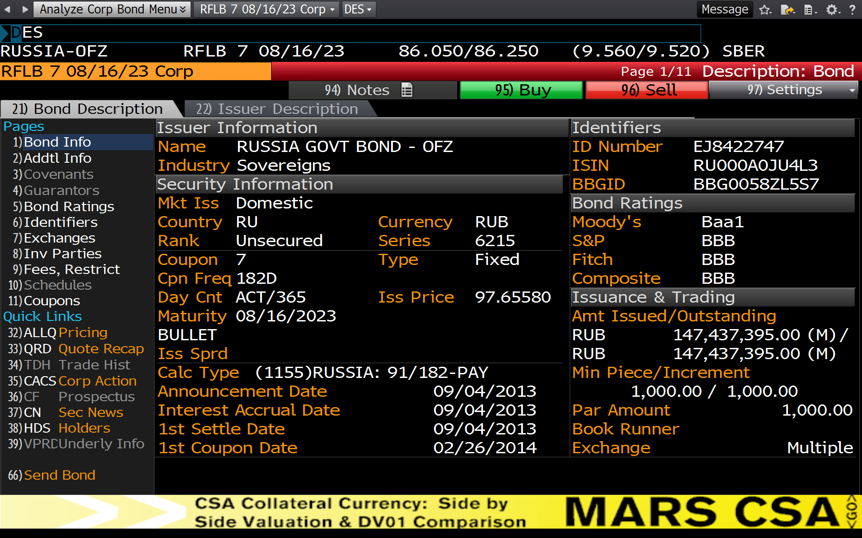
What is a Debt Contract?

Slide 7
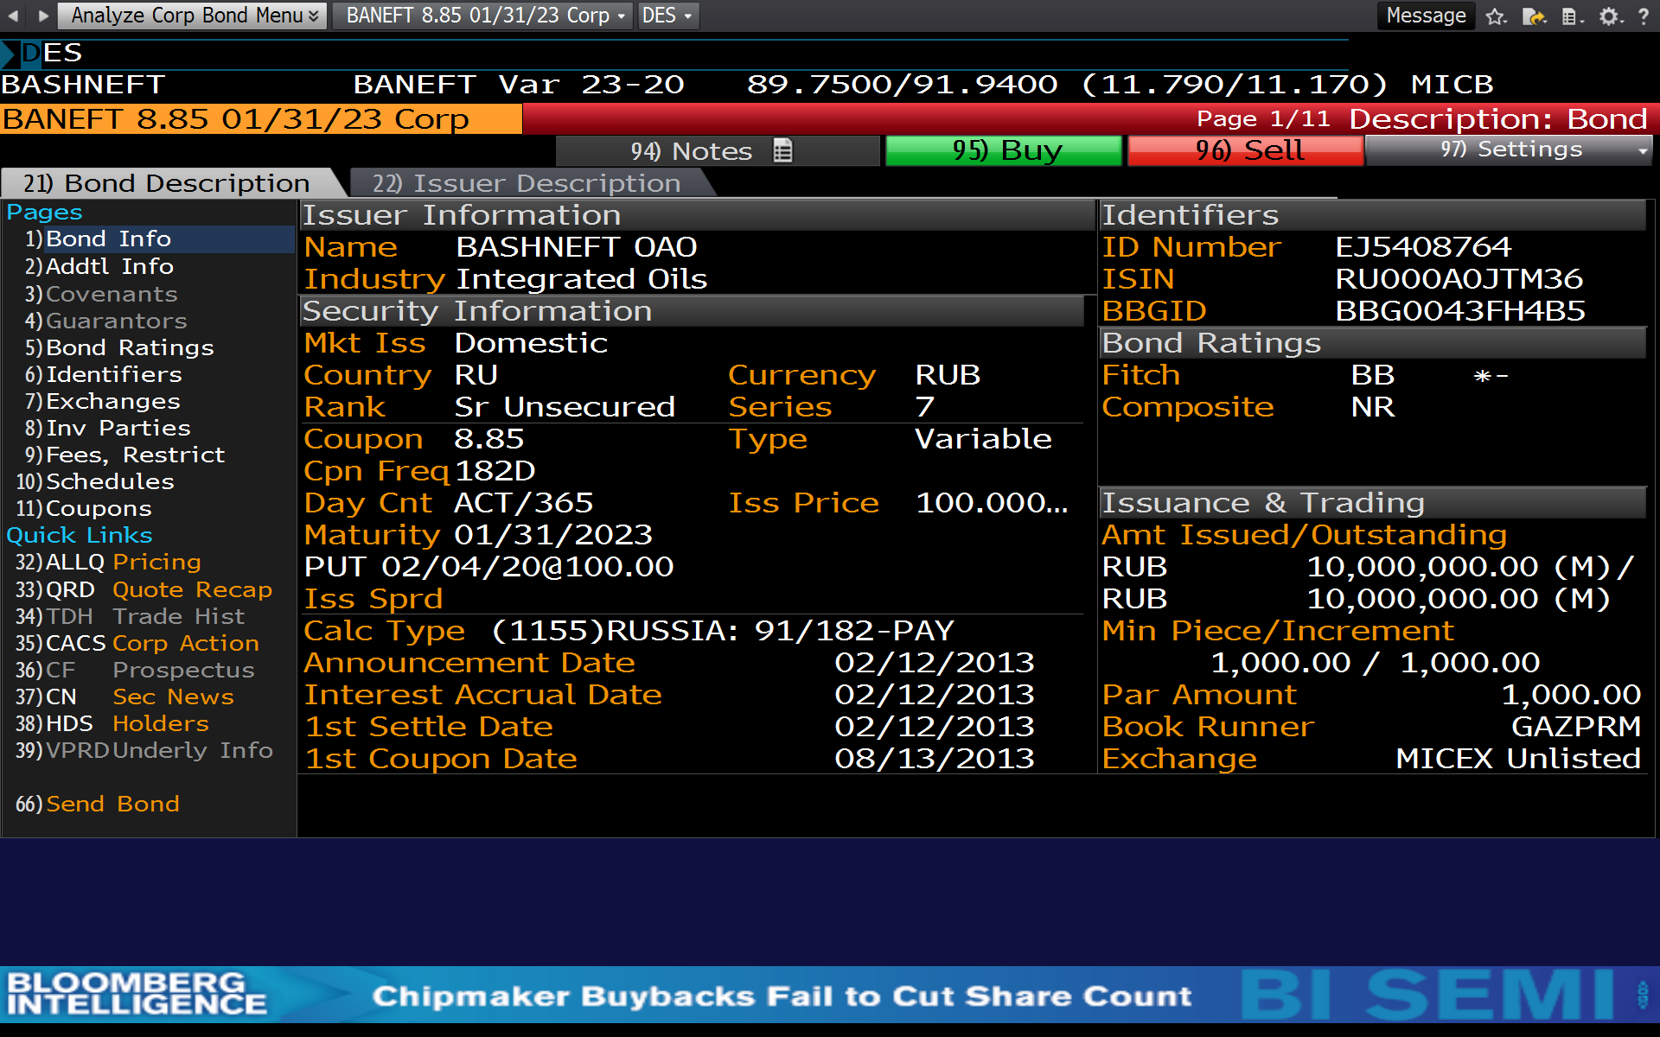
What is a Debt Contract?

Slide 8
Features of Debt Securities
Debt obligation types
Bonds
Mortgage-backed securities
Asset-backed securities
Bank loans

Slide 9
Features of Debt Securities
Classification of coupon rates
Zero-coupon bonds
Fixed-rate bonds
Step-up notes
Floating-rate securities
Inverse / Reverse floaters
coupon rate = reference rate + quoted margin
coupon rate = K - L * (reference rate)

Slide 10
Features of Debt Securities
Indenture and covenants
Affirmative covenants:
To pay interest and principal on a timely basis
To pay all taxes and other claims when due
Allow either the issuer or bondholder to alter a bond's term to maturity
Negative covenants:
Impose limitations on the borrower's ability to incur additional debt unless certain tests are satisfied

Slide 11
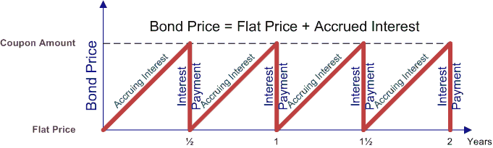
Features of Debt Securities
Accrued interest

Slide 12
Features of Debt Securities
Bond provisions
Amortizing securities
Prepayment option
Sinking fund requirement
Tender offer

Slide 13
Features of Debt Securities
Embedded options
Embedded options granted to issuers:
The right to call the issue (fixed-price call / make-whole call)
The right of the underlying borrowers in a pool of loans to prepay principal above the scheduled principal payment
The cap on a floater
Embedded options granted to bondholders:
Conversion privilege
The right to put the issue
Floor on a floater

Slide 14
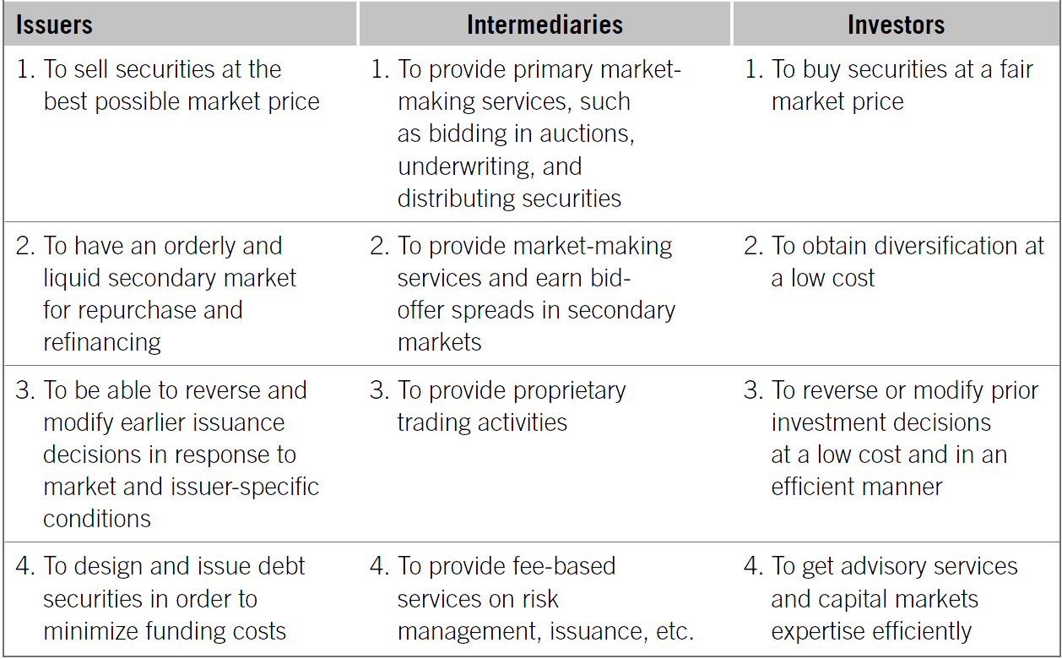
Market Players Objectives

Slide 15
Overview of Bond Sectors
Commercial paper
Short-term unsecured promissory notes issued in the open market as an obligation of the issuing entity
Maturity is typically less than 270 days
Investors in commercial paper are institutional investors

Slide 16
Overview of Bond Sectors
Corporate debt instruments
Security Type | Pledge
Mortgage bond | Lien (a legal right to sell mortgaged property)
Collateral trust bond | Collateral (stocks, notes, bonds, real estate)
Debenture bond | Unsecured
Subordinated debenture bond | Unsecured (ranks after secured debt, debentures bonds, and often after some general creditors)

Slide 17
Overview of Bond Sectors
Corporate debt instruments
Rule 144A
Provides non-issuers with exemption from the registration requirements of the Securities Act for resales to qualified institutional buyers
Allows a non-U.S. issuer to avoid the registration requirements of the Securities Act
Provides the non-U.S. issuer with greater control over timing of the offering (potentially quicker access to the U.S. capital markets)

Slide 18
Overview of Bond Sectors
The Eurobond market
Bond Market Sectors
Internal Bond Market
External Bond Market (the Eurobond Market)
Domestic Bond Market
Foreign Bond Market

Slide 19
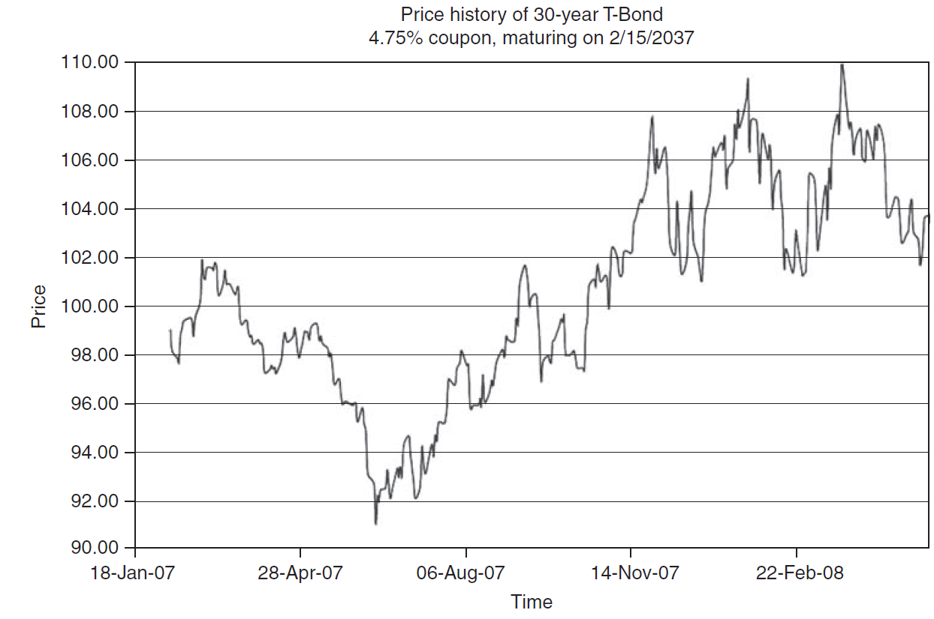
Debt Securities Risks
Interest rate risk

Slide 20
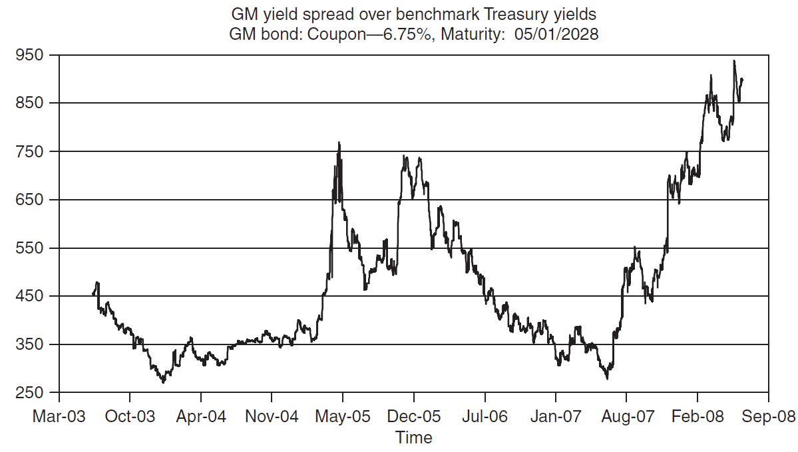
Debt Securities Risks
Credit risk

Slide 21
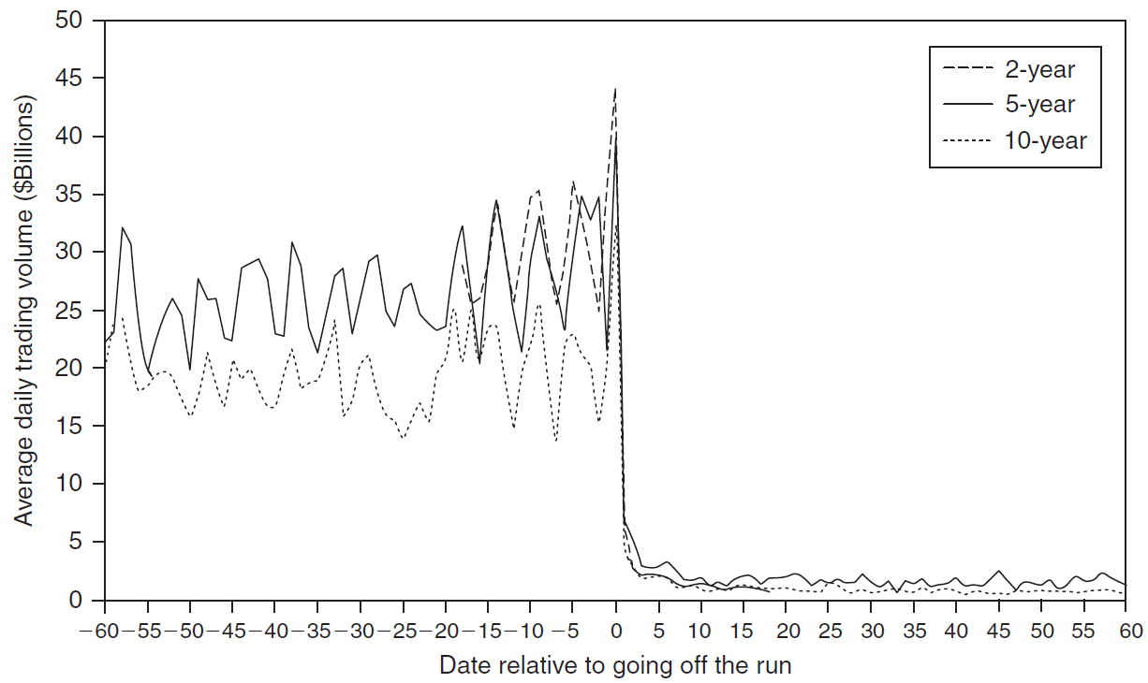
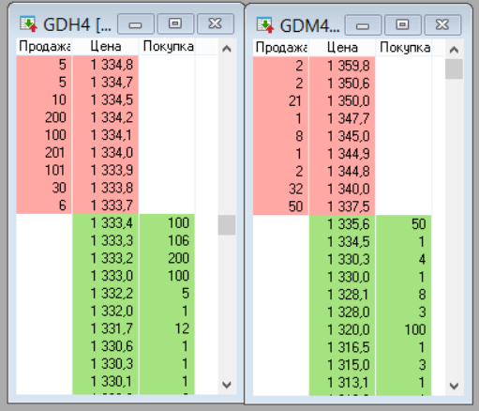
Debt Securities Risks
Liquidity risk

Slide 22
Debt Securities Risks
Contractual risk
Inflation risk
Event risk
Tax risk
FX risk
… and more

